Slide 1
Sprout: an app for house plant enthusiasts
Keidra Carter

Slide 2


Business Context
Sprout was created with 2 main intentions:
Plant Care Reminders Alert plant owners when watering, repotting, fertilizing, etc. are needed!
Community Allow members of the plant community to share their collection and knowledge.

Slide 3
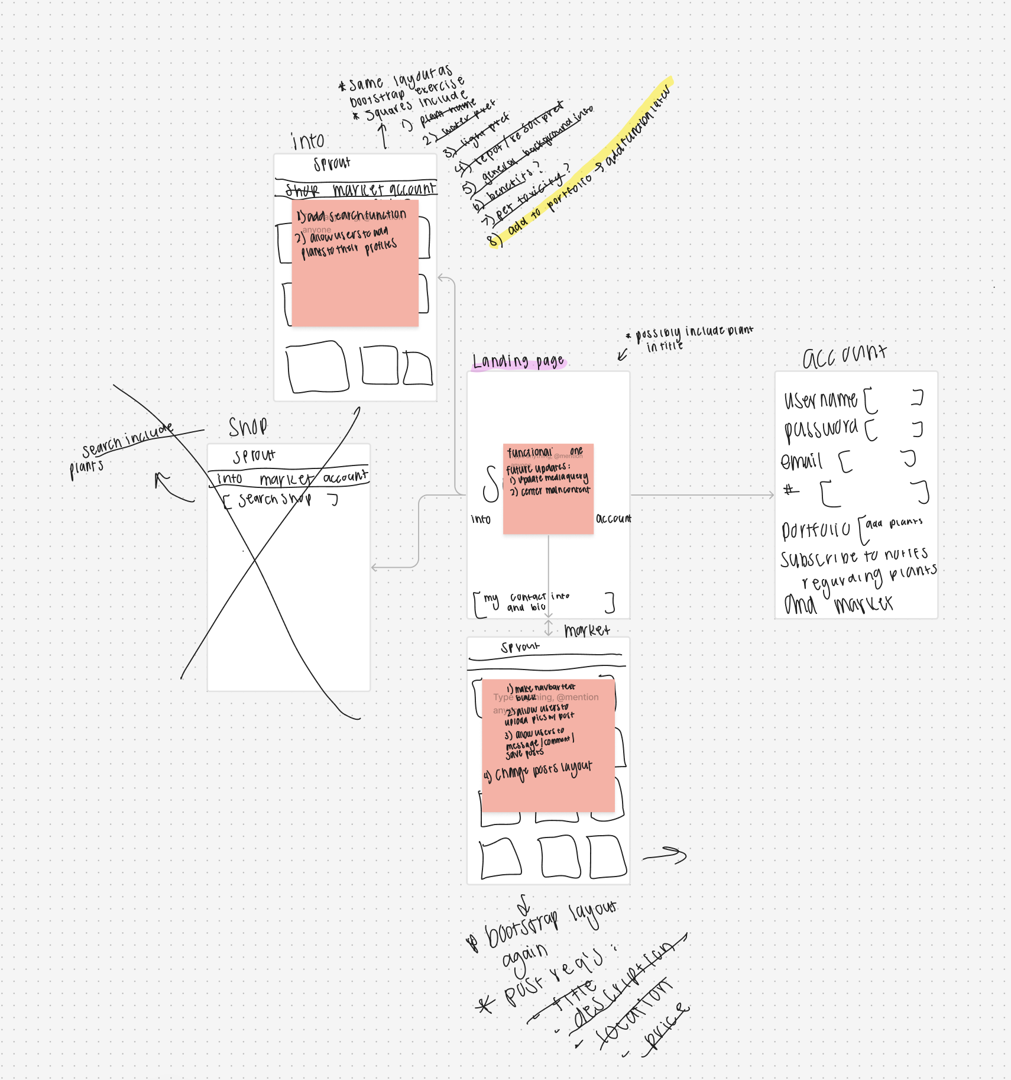
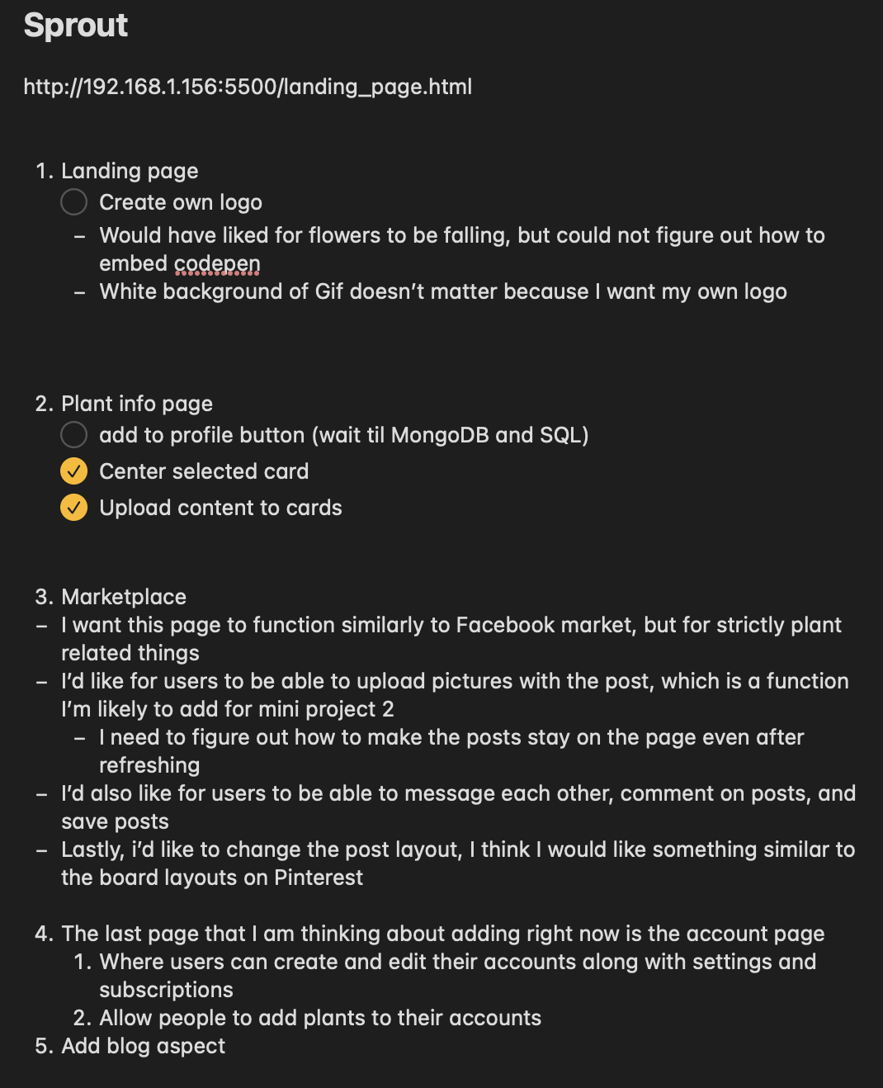
Creation
Figma
Lists
User Stories
# | Title | Pri. | Notes
1 | Search Plants on the Plant Info Page | done | done
2 | Add Plants to Profiles | high
3 | Create Profiles | high

Slide 4
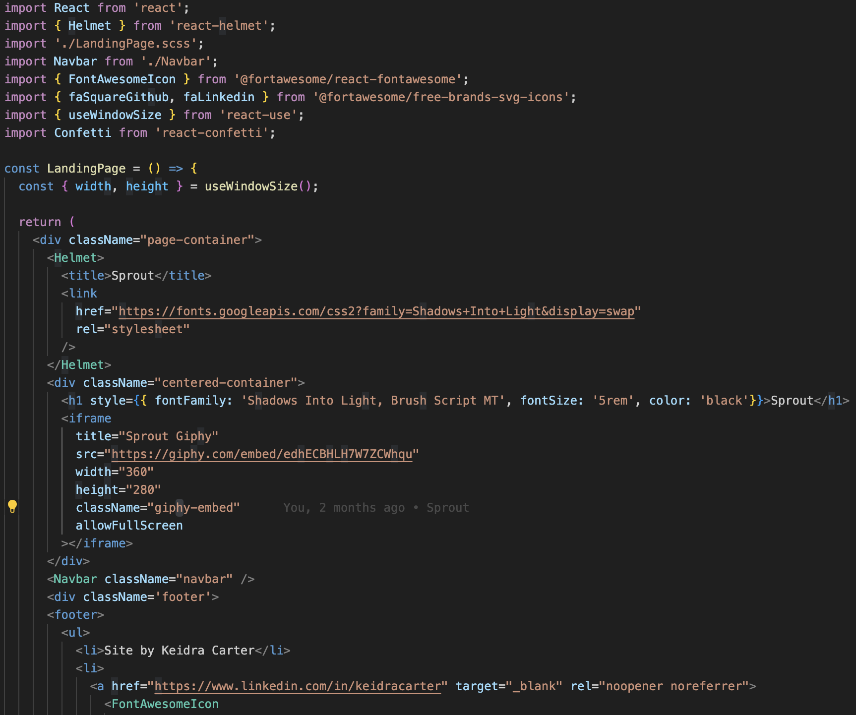
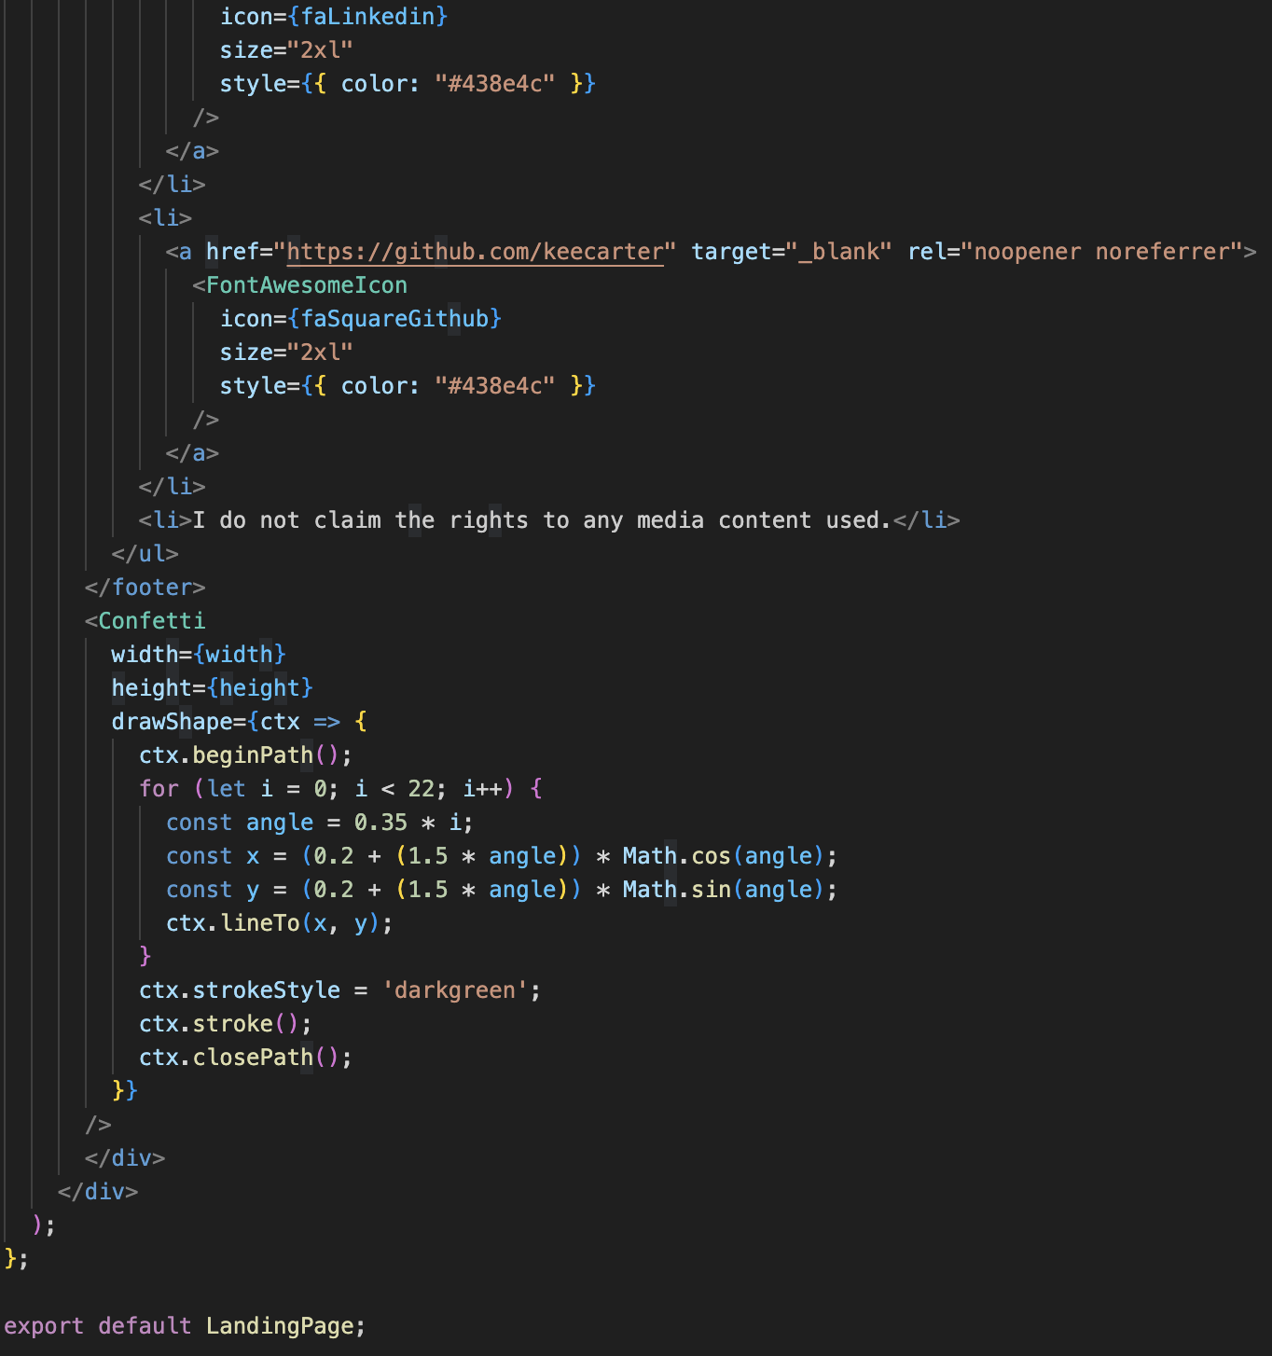
Home Page
Font imported from Google
Confetti imported from npm react package
Giphy embedded via iframe
Navbar created via bootstrap
Contact icons imported from FontAwesome

Slide 5
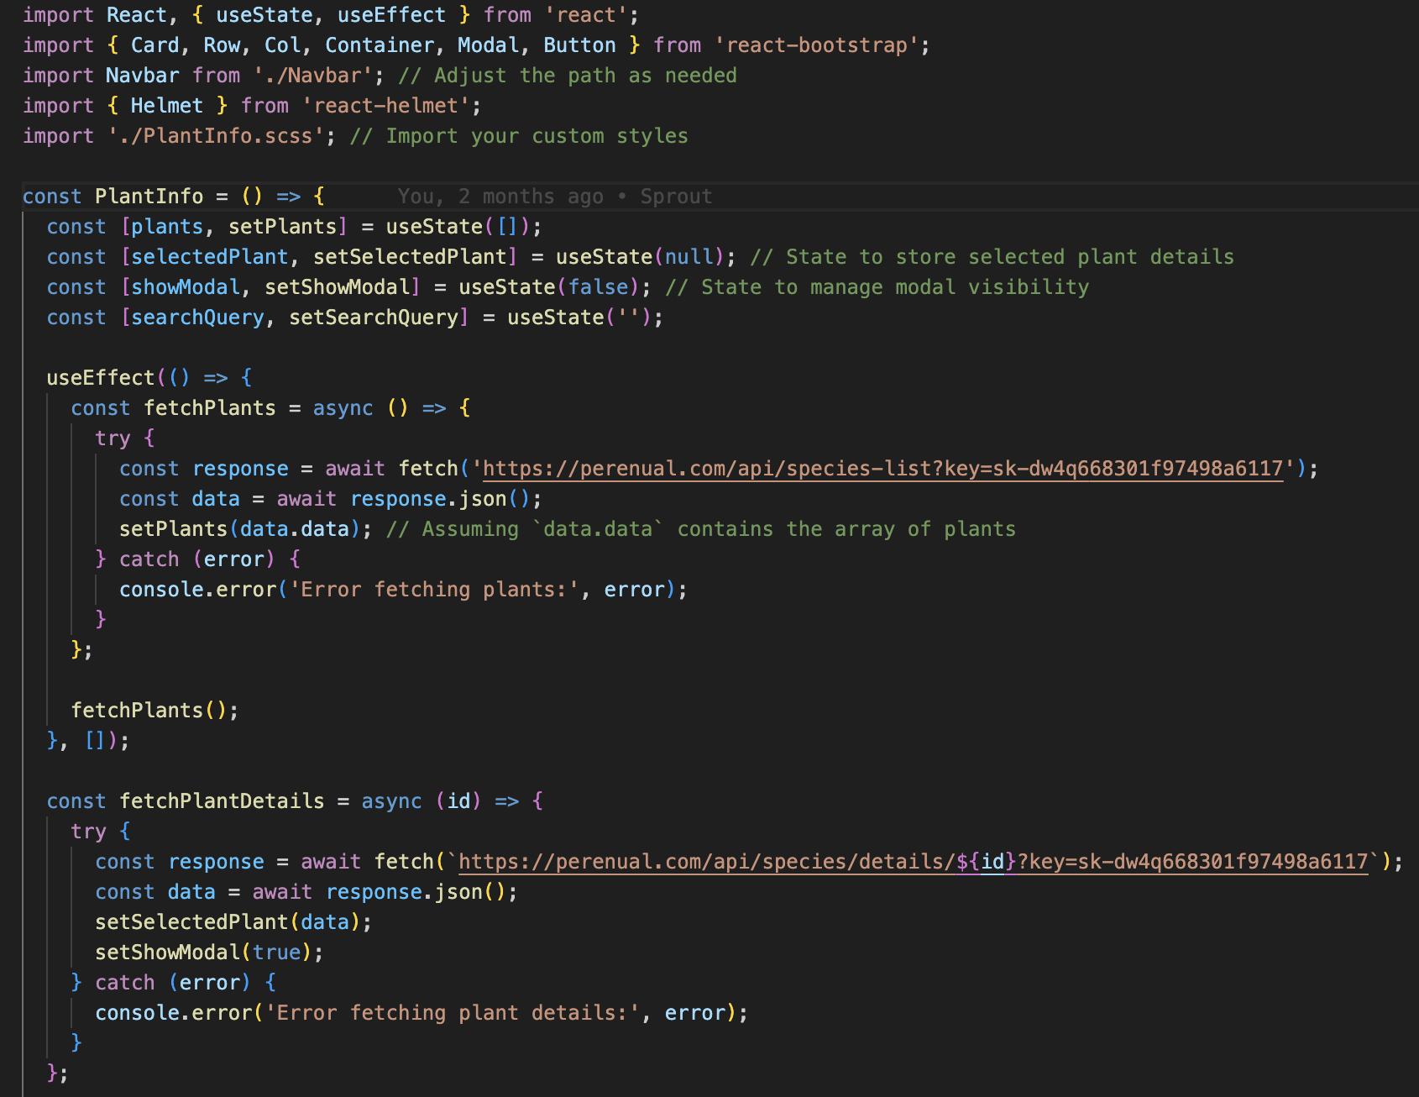
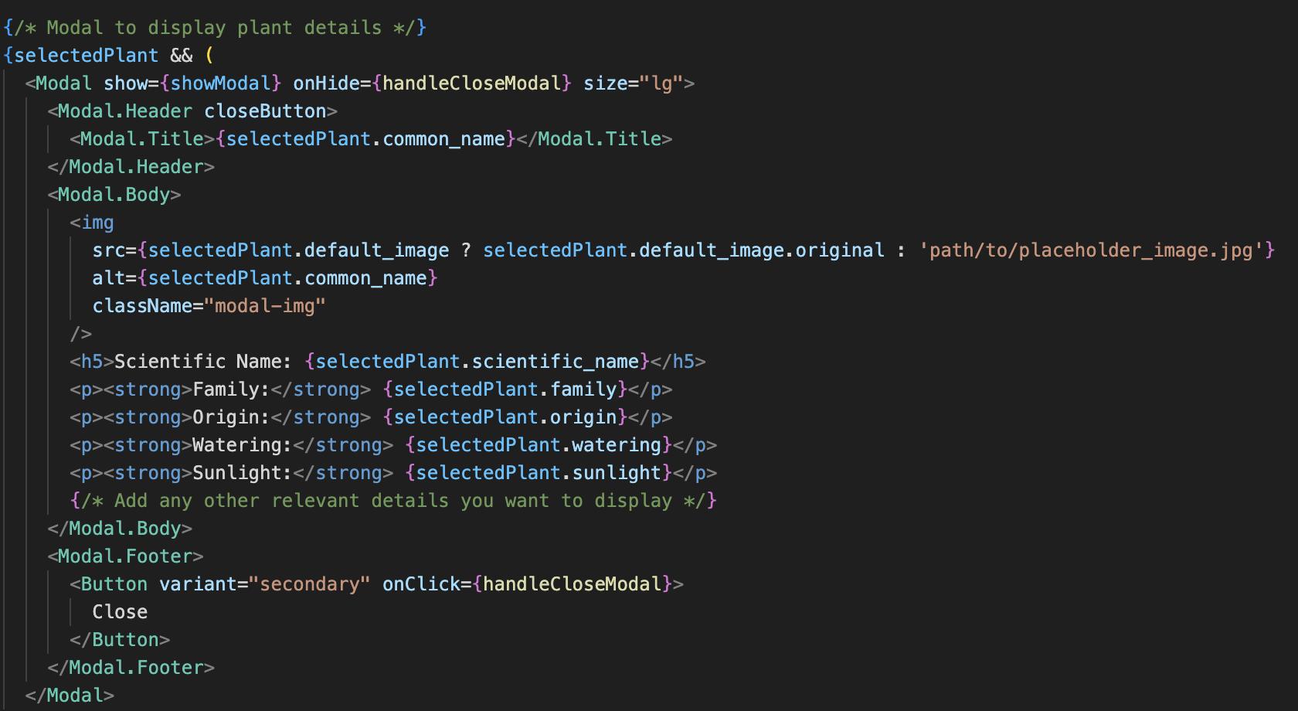
Plant Info Page
Font imported from Google
Utilizes bootstrap to organize cards
Fetching data from external plant API utilizing useEffect
Utilizes React Modal component to single out selected card

Slide 6
More to Come…
Account and Market features
Change overall UI

Slide 7
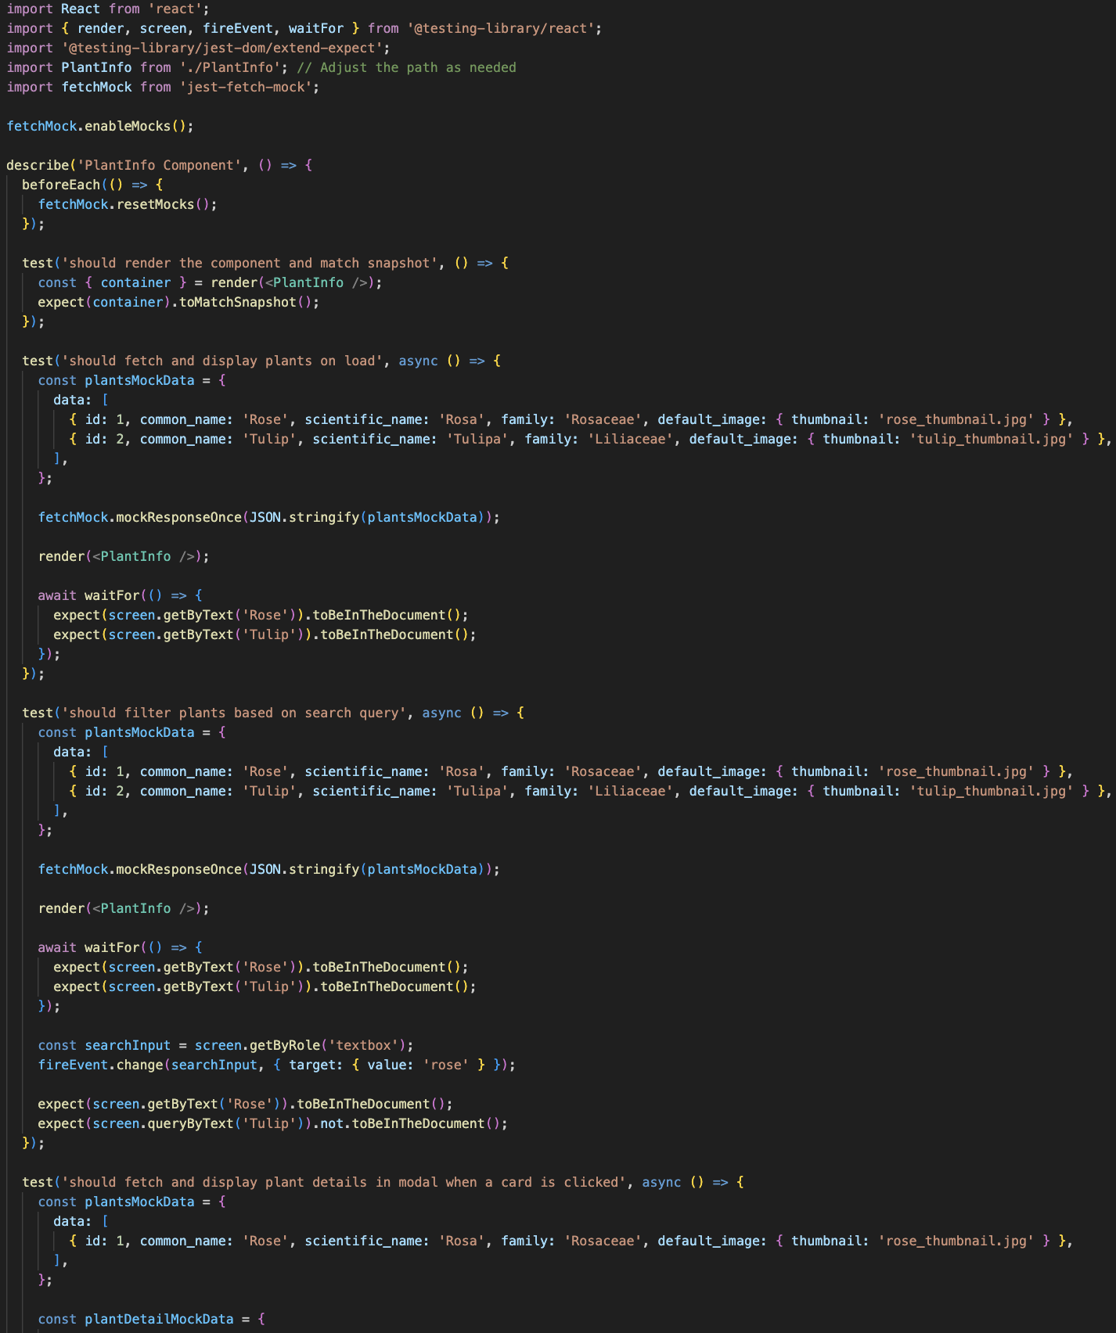
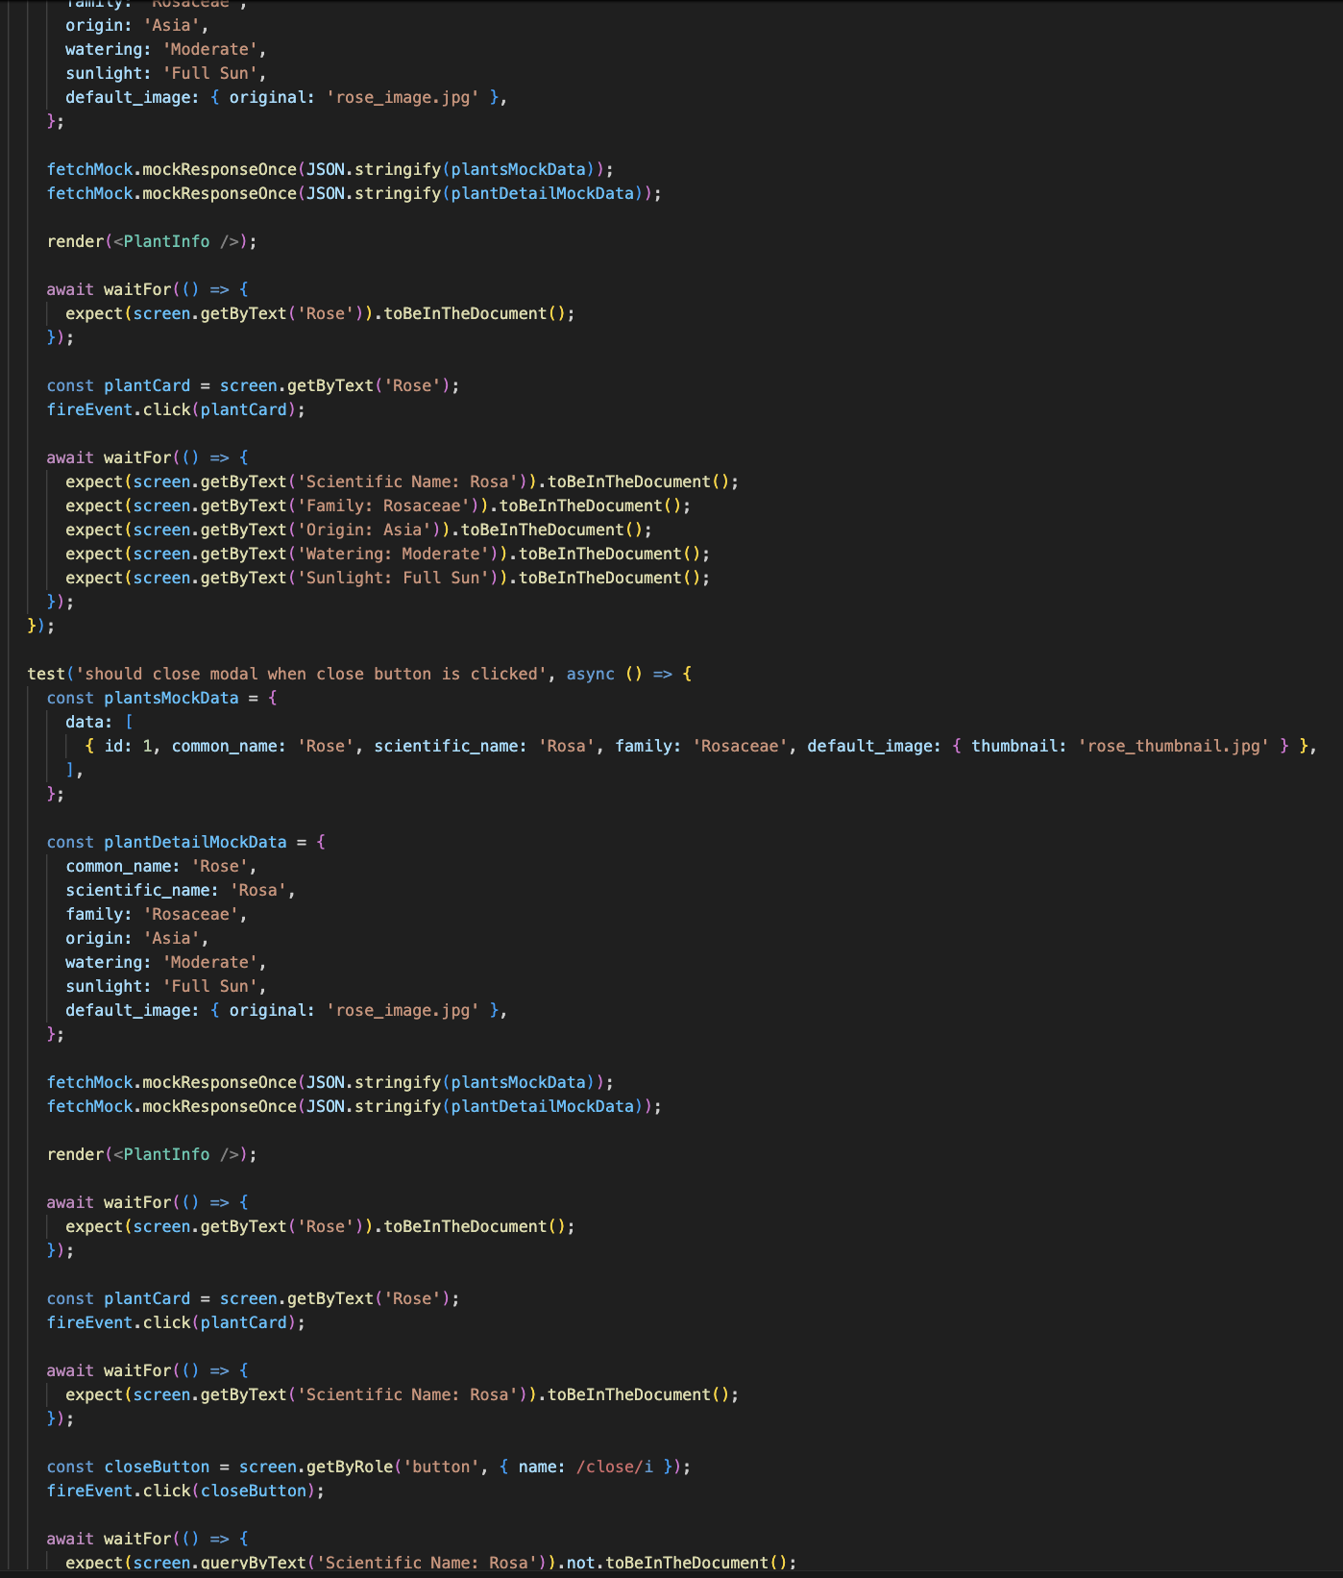
Testing
Snapshot Test
Fetch Plants Test
Search Functionality Test
Fetch Plant Details Test:
Modal Close Test

Slide 8
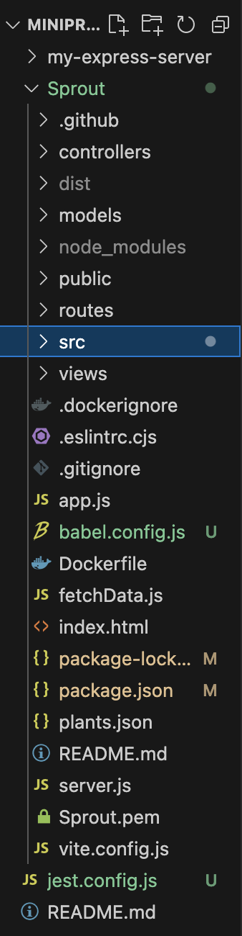
Organization

Slide 9
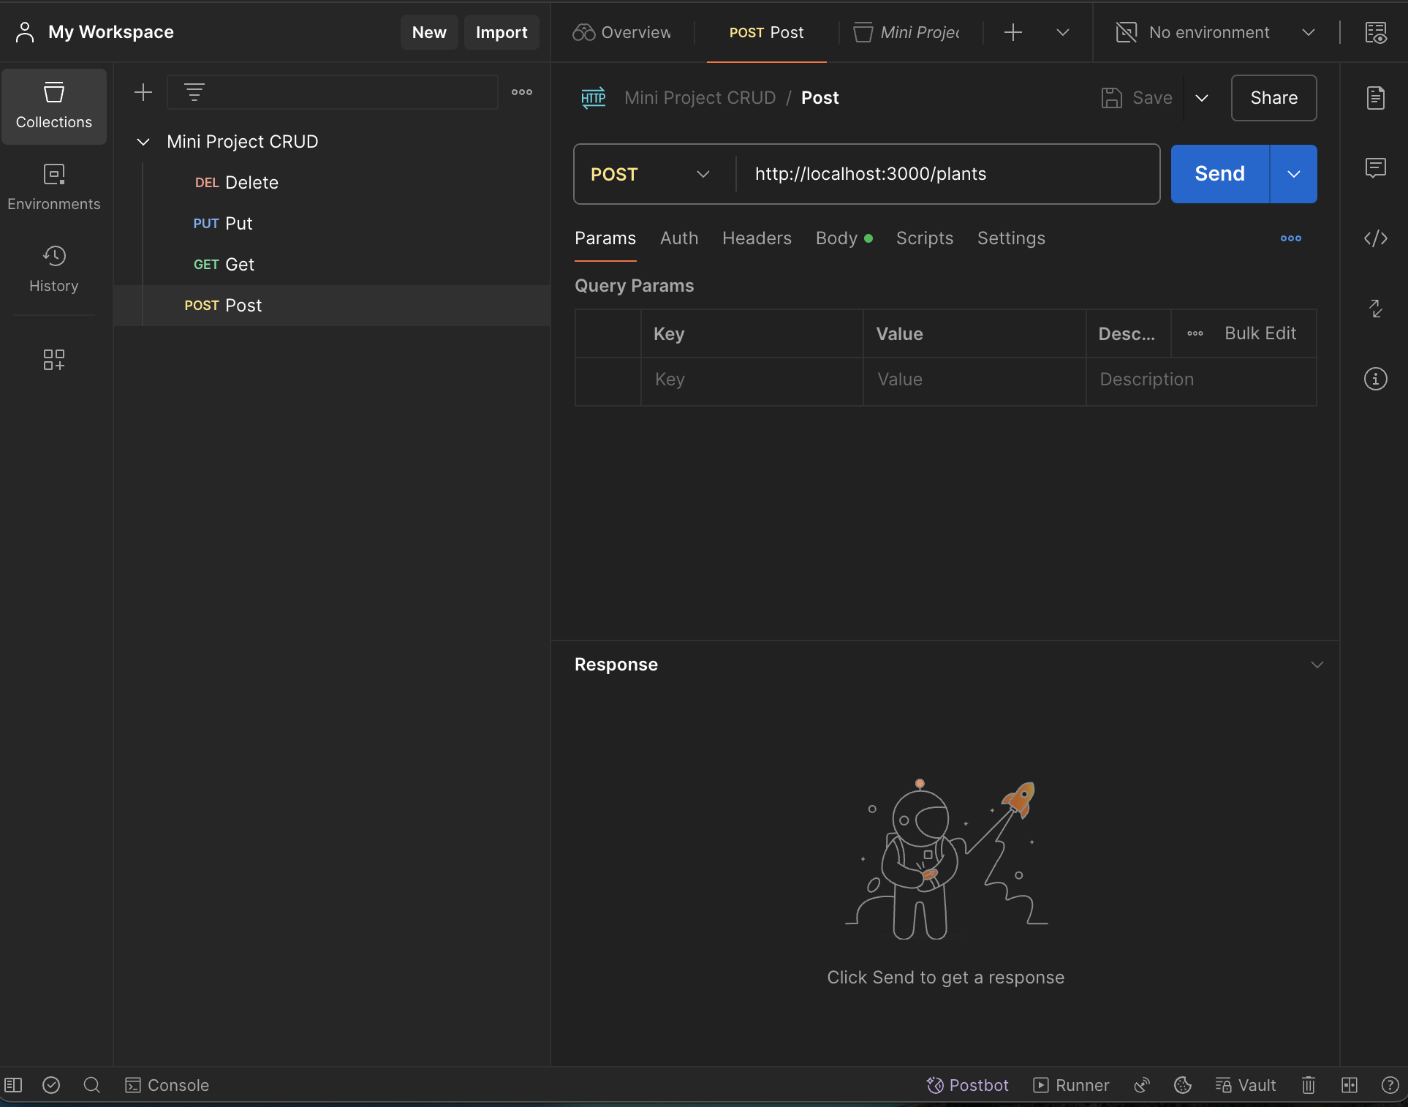
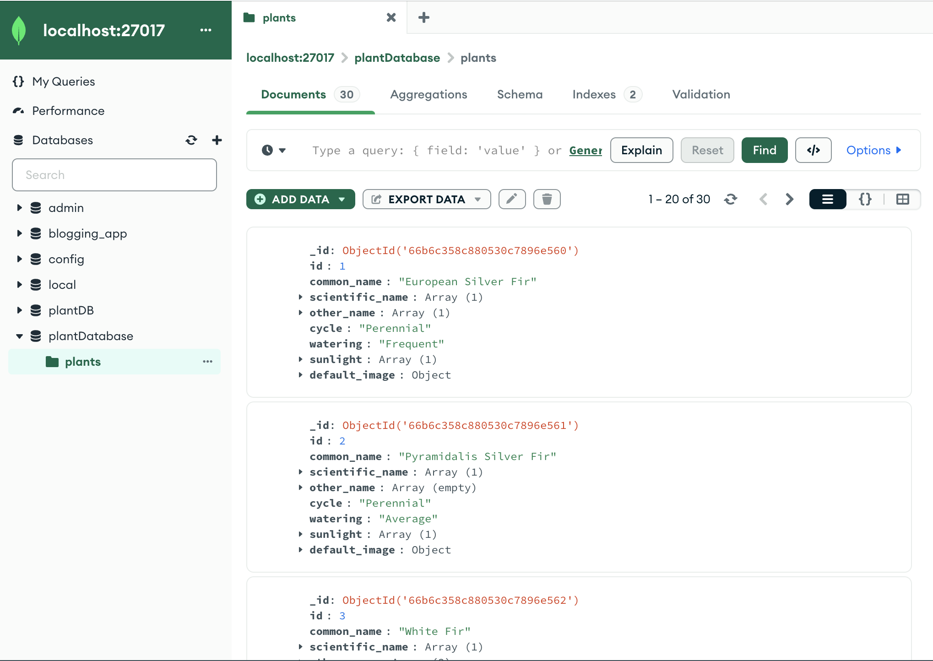
Database…
External database via MongoDB
CRUD operations ran through Postman

Slide 10
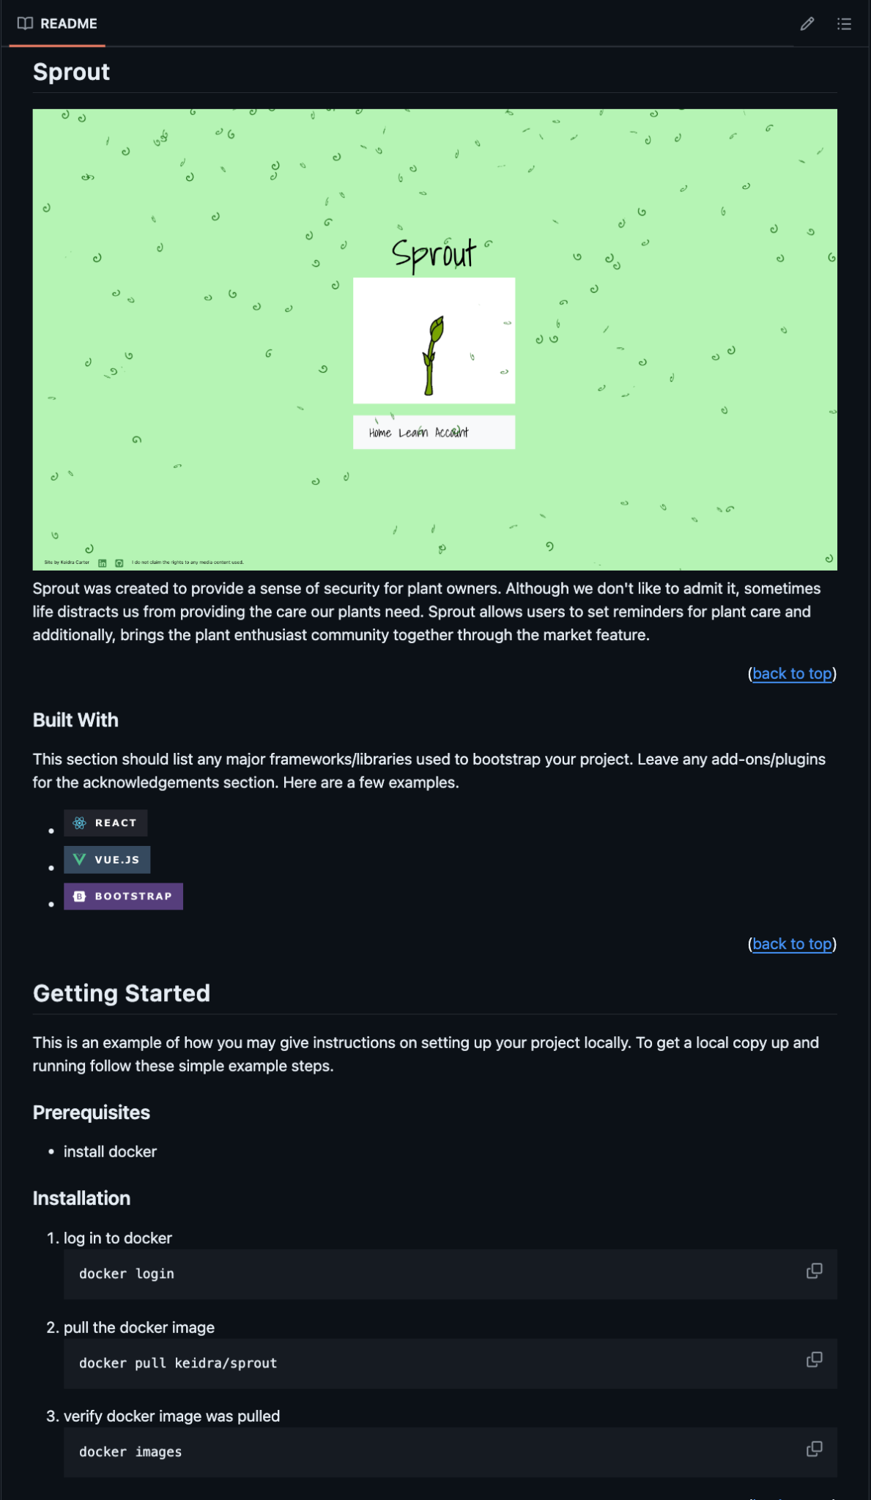
How to Install

